Slide 1
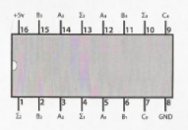
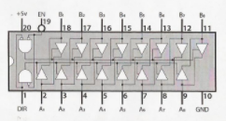
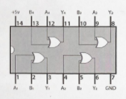
Ben Eater’s 8 Bit Computer
A
74LS283:
4-bit binary adder
74LS245:
8-bit bus transceiver
B
74LS283:
4-bit binary adder
74LS86:
XOR gate
74LS86:
XOR gate

Slide 2
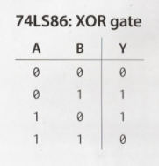
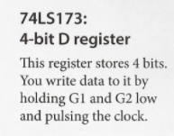
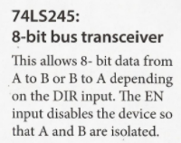
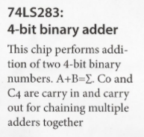
Ben Eater’s 8 Bit Computer

